Slide 1

What a Modern Perry Preschool Project Has Taught Us about Early Childhood Investment
John A. List
The University of Chicago · NBER

Slide 2
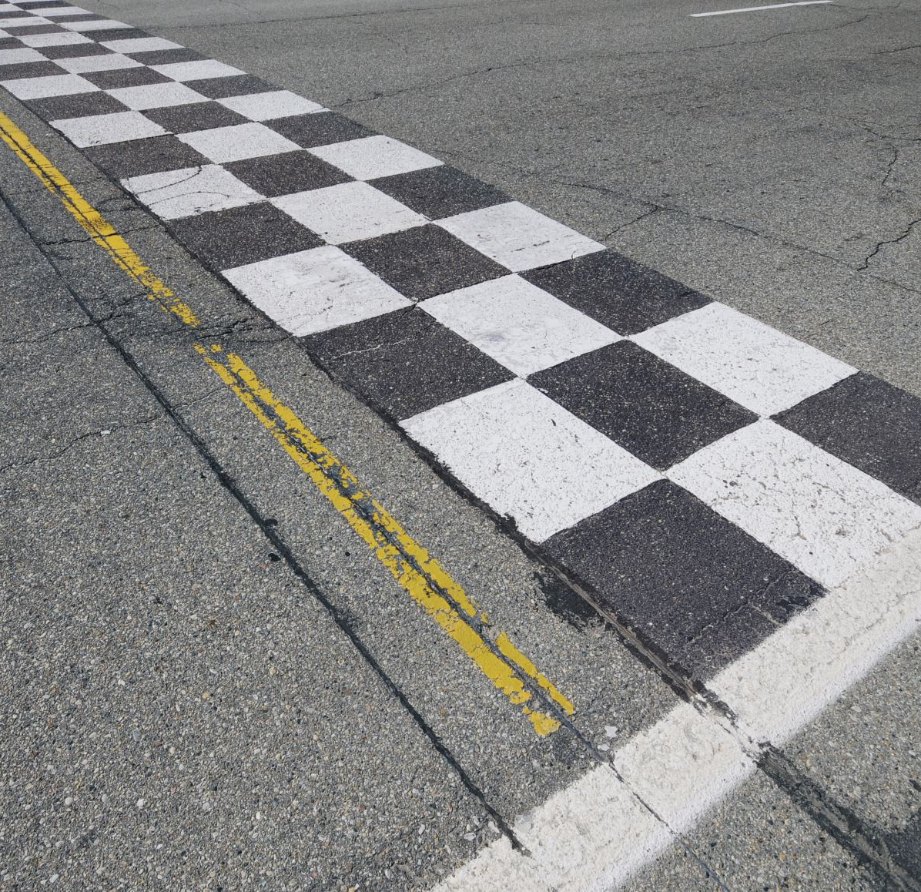
This Research Road
All started with a plea for help

Slide 3
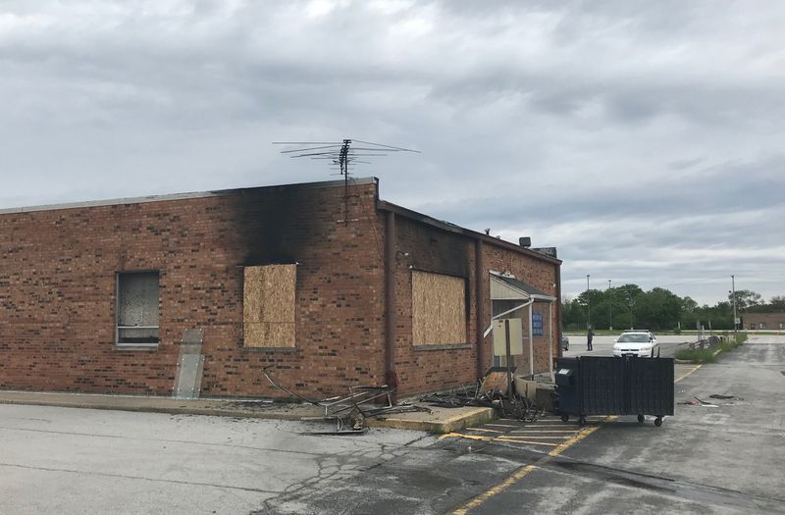
Chicago Height’s
2006 Request
Can you help us
in any way possible?

Slide 4
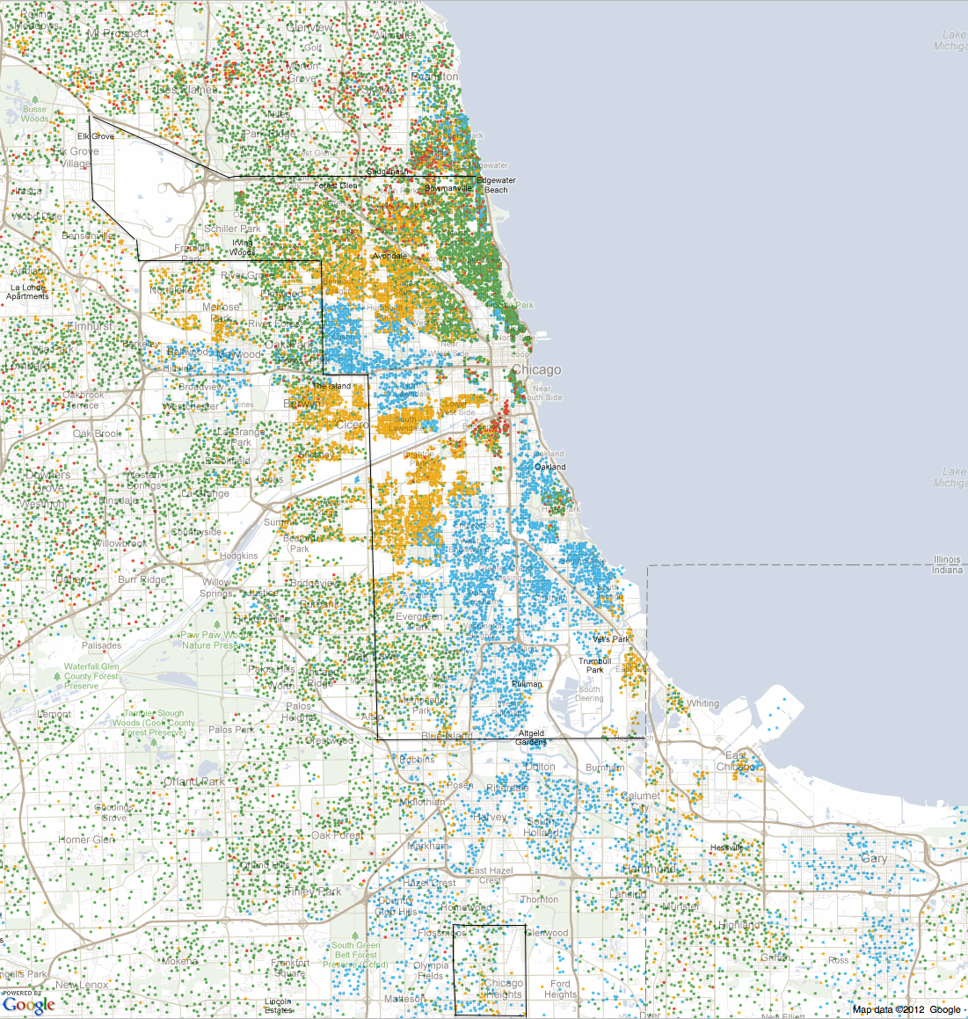
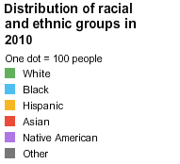
Chicago
Chicago Heights

Slide 5
Where We Started: High School
“Chicago Heights Miracle”

Slide 6
WHERE WE STARTED · A CONFESSION
Three numbers I have believed about this program
2008, mid-stream, I told the press the $400,000 experiment had kept 25–40 potential dropouts on track for a diploma: “call it $10,000–$16,000 per graduate”…. “Per student, that’s pretty expensive.”
Then, with two years of data, the paper projected $1,200 per additional graduate, driven by threshold students, +14 p.p. on track in year 1 and +12 p.p. in year 2, exactly where the model said to look.
Then year 4 arrived: the on-track gains halved, then vanished, no impact on graduation, even for threshold students.
Same program, three horizons, three answers. The estimand depends on when you stop measuring!
Levitt, List, and Sadoff, “The Short and Long-Term Effects of Performance-Based Incentives on Educational Achievement: Evidence from a Randomized Experiment,” NBER Working Paper No. 22107.
per additional graduate — projected from the years 1–2 threshold effects

Slide 7
THE STARTING POINT
Perry showed how preschool could transform lives — but left some big questions open
WHY
does it work? Mechanisms were a black box
The Perry Preschool Project (1962–67) randomized 123 disadvantaged children in Ypsilanti and tracked them for decades. Graduation, earnings, and crime all moved. Rates of return of 7–10% reshaped policy.
But Perry was a product of its era: one treatment, one site, small sample, and 40 years of waiting before the evidence crystallized.
It could tell us that early investment works. It could not tell us why it works, which components matter, or how to deliver them at scale.
WHICH
components matter? Everything was bundled
HOW
does it scale? One site, 123 children
Heckman, Moon, Pinto, Savelyev & Yavitz, “The Rate of Return to the HighScope Perry Preschool Program,” Journal of Public Economics 94 (2010); Perry follow-ups through age 54.

Slide 8
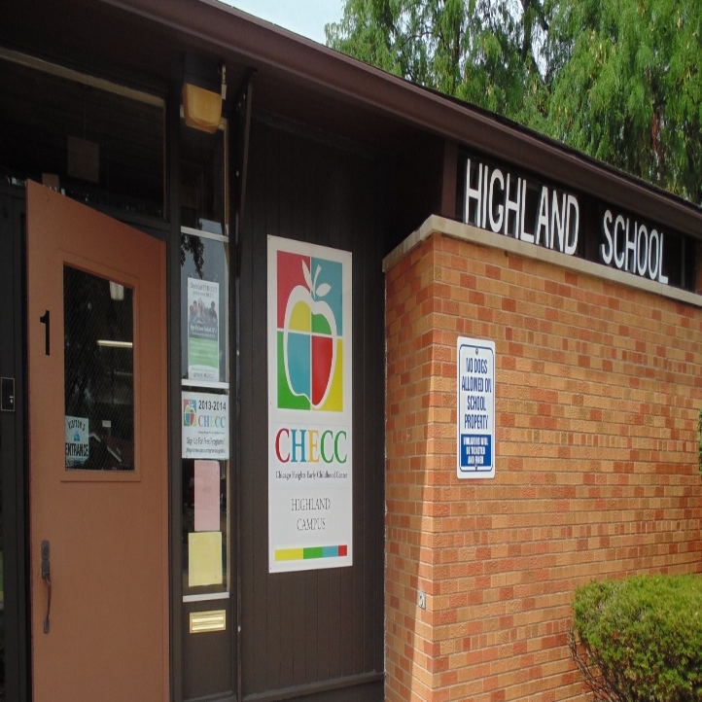
My Idea: Let’s Start Our Own Pre-K!
Started building a Pre-K in 2008
3-5 year olds as the target population
3 major goals
Perry and I asked the same question. We just had in mind different estimands
Perry estimated whether the bundle works; I wanted to estimate the objects that decide when, why, and at what scale it works

Slide 9
FROM PERRY TO CHECC
The system we take to the data
θ_{i,t+1} = f_{t}( θ_{i,t}, P_{i,t}, S_{i,t}, C_{i,t}, E_{i,t} ) Z_{i,t} = λ_{t} θ_{i,t} + ε_{i,t} Y_{i} = g( θ_{i,T} ) at scale n: F(n), fₙ, S(n), E(n), C(n)
The child’s system
Measurement, outcomes, scale
What builds skill — the arguments of f
What we observe — and what it buys
θ — the child’s skill stock at age t: the state of the system
f — the technology of skill formation, varying with age t
P — parental investment: the home’s inputs, beliefs, and norms
S — schooling: what the classroom delivers
C — the child’s own investment: the effort the child brings to f
E — the environment: other children’s skills enter through Σwᵢⱼθⱼ
Z — test scores: what we measure, not the object itself
λ — the measurement map from θ to Z; ε — the noise around it
Y — adult outcomes: college, work, conduct
g — the outcome map: which coordinates of θ the world prices
n — scale: an argument of the whole system, not an afterthought
At scale: capital F is who you serve, little f is what you deliver, S is what you can staff, E is what surrounds the child in equilibrium, and C(n) is what it costs — every one of them moves when n does.

Slide 10
FROM PERRY TO CHECC
Same question — a different estimand
What Perry identifies
ATE and a few CATEs, all reduced-form
The return to one bundle: f, P, S, C, and E enter jointly; subgroup cuts (gender, baseline IQ) slice the same composite, never separate the inputs
One site, one situation: a single draw of F and f
Scores stand in for skills: λ assumed to be the identity map
Y arrives after a 40-year wait; n = 123 is silent on scale

Slide 11
FROM PERRY TO CHECC
Same question — a different estimand
What Perry identifies
What CHECC is built to identify
ATE and a few CATEs — all reduced-form
The objects behind the number
The return to one bundle: f, P, S, C, and E enter jointly — subgroup cuts (gender, baseline IQ) slice the same composite, never separate the inputs
One site, one situation: a single draw of F and f
Scores stand in for skills: λ assumed to be the identity map
Y arrives after a 40-year wait; n = 123 is silent on scale
E: Σwᵢⱼθⱼ — peers and neighborhoods, randomized and measured
P — parental capital: built early, pays off in bad states
C — the child’s own effort: chooseable, priced — and inside the score Z
λ — the measurement map, tested against a second technology (EEG)
g — which coordinates of θ carry into Y
n — scale as an argument of the system, not an afterthought
Perry answers “does it work?” CHECC is designed to answer why, through what, for whom — and at what scale.

Slide 12
THE DESIGN
Who was randomized to what: nearly 3,000 children in two phases
Phase 1 · 2010–12
1,434 children randomized across five arms
Pre-K · Tools of the Mind
n = 164
Pre-K · Literacy Express
n = 170
Parent Academy · Cash
n = 186
Parent Academy · College
n = 186
Control
Control
n = 728

Slide 13
THE DESIGN
Who was randomized to what: nearly 3,000 children in two phases
Phase 1 · 2010–12
Phase 2 · 2012–14
1,434 children randomized across five arms
~1,500 children randomized to CogX dosages
Pre-K · Tools of the Mind
n = 164
CogX · 12 months
n = 150
Pre-K · Literacy Express
n = 170
CogX · 9 months
n = 150
Parent Academy · Cash
n = 186
KinderPrep · 2-month summer
n = 150
Parent Academy · College
n = 186
Control
n = 1,054
Control
n = 728
Parent Academy incentives paid in cash or in college scholarship funds — an experiment inside the experiment. CogX overlays the Parent Academy, treating each component of the production function.

Slide 14
THE MEASUREMENT SPINE
What we measured, and when
The cadence
Cognitive battery (normed)
Pre-assessment
PPVT — Peabody Picture Vocabulary Test (receptive vocabulary)
Woodcock-Johnson III: Letter-Word Identification, Spelling, Applied Problems, Quantitative Concepts
Fall intake: cognitive + non-cognitive baseline for every child
Mid-year assessment
Same battery, mid-program
Post-assessment (June)
End-of-program skills; the treatment-effect anchor
Non-cognitive & behavioral
Annual follow-ups
Executive function: inhibitory control (spatial conflict), operation span; PSRA self-regulation assessment
Incentivized behavioral-economics experiments — 50+ studies on the platform: patience, sharing, cheating, discrimination, competitiveness
Later layers: parental beliefs & time diaries, classroom peers, EEG brain activity
Through elementary and middle school, with district records: grades, discipline, attendance, classrooms
Adulthood
Arnold Ventures tracking: graduation, college, labor markets

Slide 15
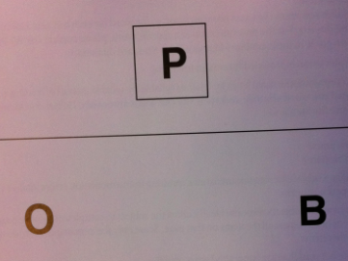
COGNITIVE:
Letter-Word/Receptive Vocabulary
In this part, each child was asked to name letters out loud from a list.
“What letter/word is this?” – Letter-word

Slide 16
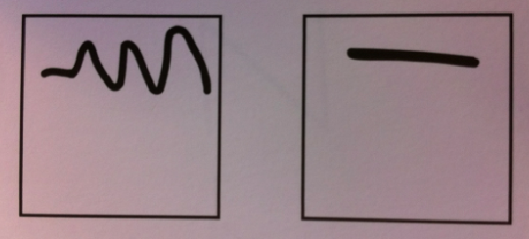
COGNITIVE
Spelling
In this part, each child was asked to draw shapes and letters.
“Can you draw a line like this one”?
Can you write the Letter “A”?

Slide 17

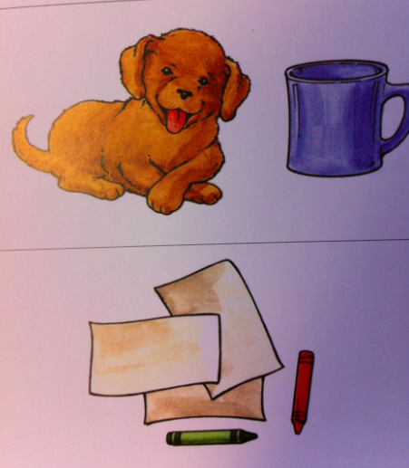
COGNITIVE
Applied Probs. / Quant.Concepts
In this part, each child was asked to count, solve problems, and identify shapes.
“What shape is this?” “How many dogs are in this picture?”

Slide 18
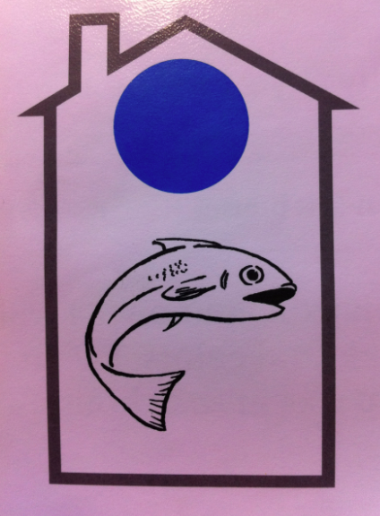
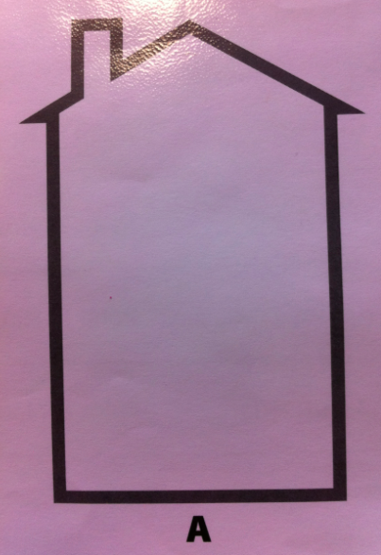
NON-COGNITIVE
Operation Span (Clancy 1)
“What color is in this house”?
“What color WAS in this house”?

Slide 19
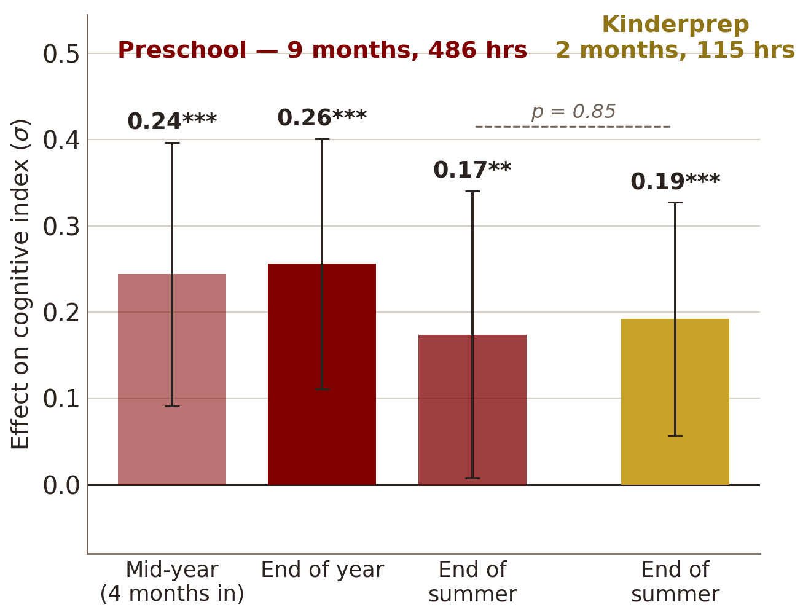
CORE RESULTS · THE EVIDENCE
A · Cognitive effects by arm and timing
Fryer, Levitt, List & Samek (2020), “Introducing CogX: A New Preschool Education Program Combining Parent and Child Interventions.” ITT estimates, full sample (Table B4); whiskers are 95% CIs. ** p<0.05, *** p<0.01.

Slide 20
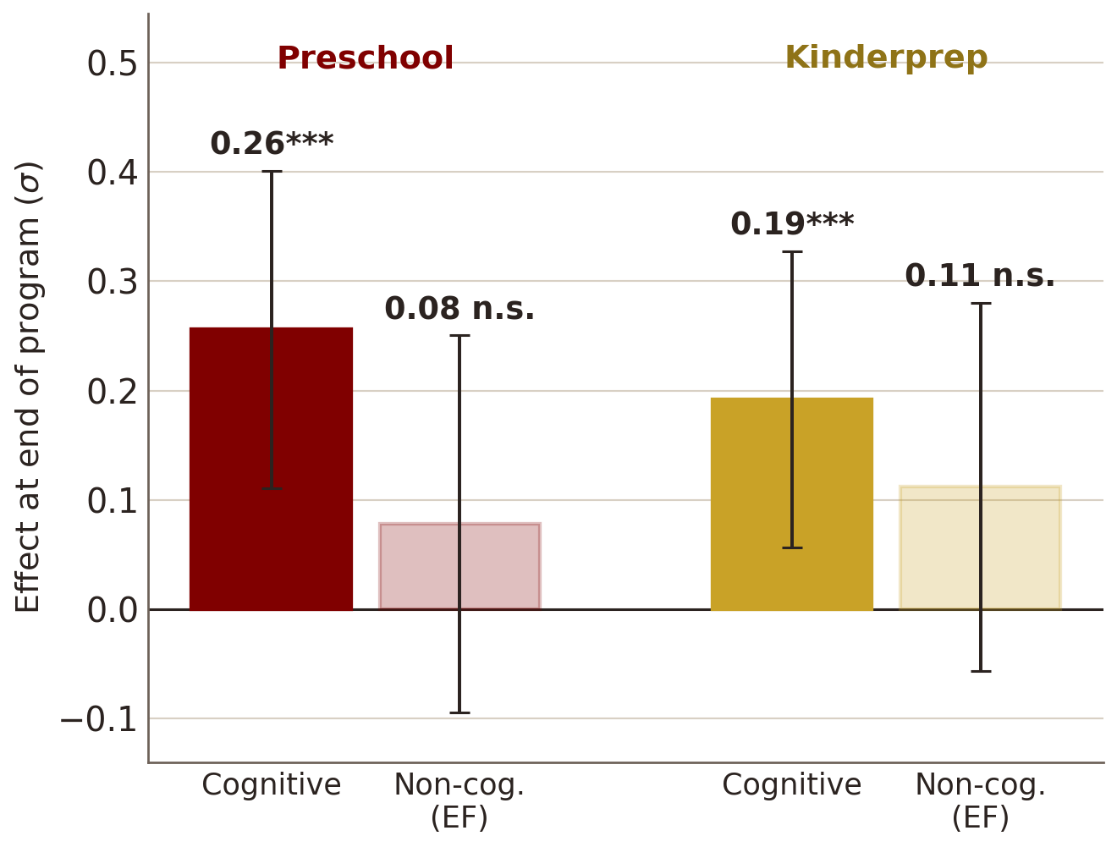
CORE RESULTS · THE EVIDENCE
A · Cognitive effects by arm and timing
B · Cognitive vs. non-cognitive, end of program
Fryer, Levitt, List & Samek (2020), “Introducing CogX: A New Preschool Education Program Combining Parent and Child Interventions.” ITT estimates, full sample (Table B4); whiskers are 95% CIs. ** p<0.05, *** p<0.01.

Slide 21
CORE RESULTS · THE EVIDENCE
Cognitive
Non-cognitive
The Parent Academy moved skills — just not for everyone
What the program moves
For whom
σ
σ
0.93***
0.4
0.22**
0.13
1.2
0.82***
0.2
0.37***
0.43***
0.6
0.0
0.0
−0.06
-0.2
-0.6
−0.23*
Cognitive
Non-cognitive
Black
Hispanic
White
Notes:
Evidence slide for the Parent Academy (2011-12 cohort, WP 21477). Panel A: pooled LATEs, Table 4 col 2 (cash/college pooled): cognitive 0.131 (0.099) n.s., non-cognitive 0.221 (0.088) p=.012. Panel B: Table 5 by race. Caveats to say aloud: White n=15; this is the PA-only 2011-12 sample, distinct from the Fryer et al. (2020) full-program accounting behind the ~0.25 sigma headline.

Slide 22



CORE RESULTS
Program Gains, Short Run
~0.25σ
Parents move
Not uniform
cognitive gains from a year of preschool
Parent Academy shifted beliefs and investments; large gains for Hispanic and White children
Near-zero Parent Academy effects for Black children; heterogeneity is a first-order finding, not a footnote

Slide 23

ONE PUZZLE IN THE FIELD
Decorated programs lift test scores. A few years later, the gains are gone. Decades later, the adults are different.
Is fade-out real skill loss? Or, an artifact of what, and whom, and how we measure? In the model's language: is it θ, f, E, or λ or a combination?

Slide 24
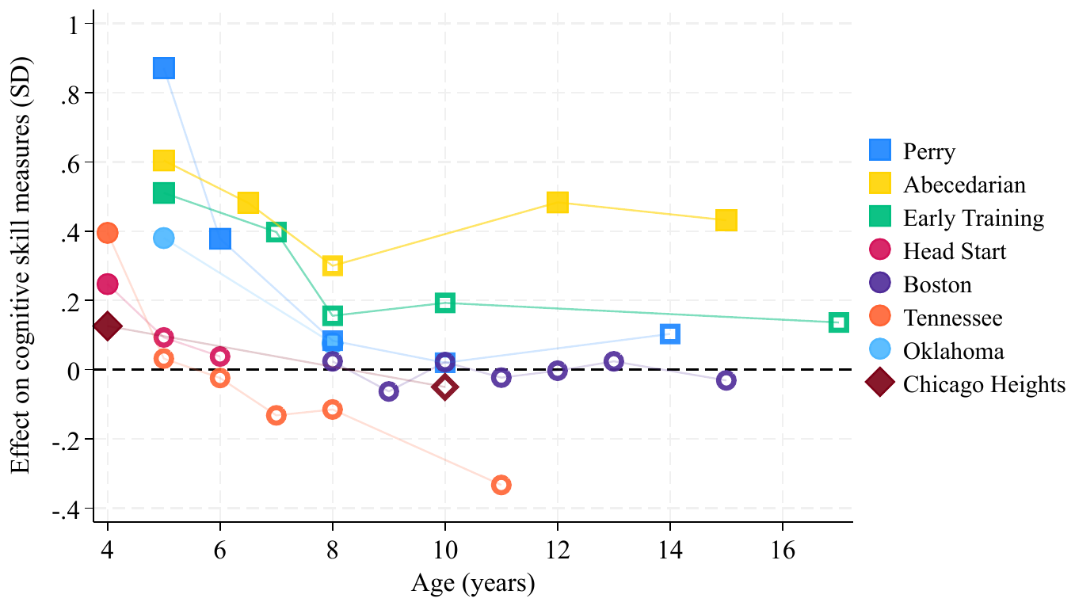
THE PUZZLE · THE EVIDENCE
Here today, gone tomorrow: gains fade by formal schooling
Across five decades of decorated programs, initial cognitive gains erode by age 8: critics’ exhibit A against early education.
List & Uchida (NBER WP 33027, 2024), Figure 1. Filled symbols: significant at the 95% level.

Slide 25


MECHANISM 1 · PEERS
CHECC: A Fade-Out Experiment Too
Two stages of randomization. First, children were randomized within CHECC. Then, with School District 170, the same children were randomized to elementary classmates, year after year.
Few treated peers
List & Uchida, “Here Today, Gone Tomorrow? Toward an Understanding of Fade-out in Early Childhood Education Programs” (NBER WP 33027, 2024).
Many treated peers

Slide 26
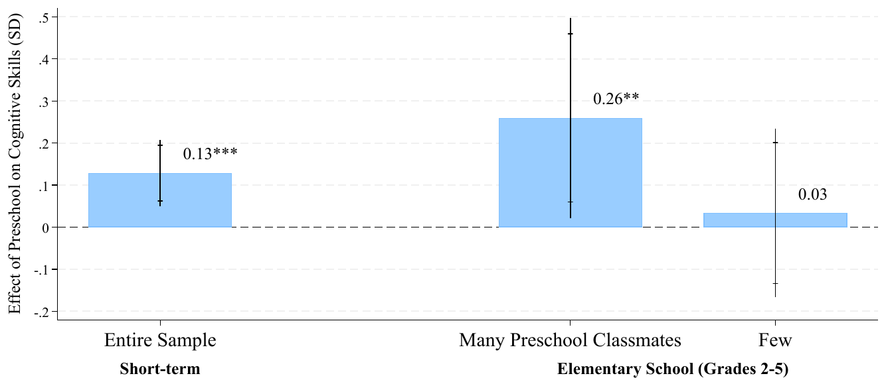
MECHANISM 1 · PEERS · THE EVIDENCE
Fade-out is not fate: treated classmates preserve the effect
0.13σ at program end grows to 0.26σ with many Preschool classmates — and vanishes (0.03) with few. Peers reverse fade-out.
List & Uchida (NBER WP 33027, 2024), Figure 3. Grades 2–5; exposure split at residualized median.

Slide 27
MECHANISM 1 · PEERS
Fade-out lives in the classroom, not the child
The payoff: with enough treated classmates, the classic fade-out effect is muted. Skills persist when the classroom sustains them; gains erode when treated children are scattered among untreated peers.
Fade-out is partly an equilibrium property of the environment we send children into,, which means it is a policy choice.
In the past fade-out has been used to argue against early childhood spending, our results provide an argument for pre-k schooling for all.
Few treated peers
Gains erode:the textbook fade-out pattern re-emerges
List & Uchida, “Here Today, Gone Tomorrow? Toward an Understanding of Fade-out in Early Childhood Education Programs” (NBER WP 33027, 2024).
Many treated peers
Fade-out is muted: skills persist through elementary school

Slide 28
THE FRAMEWORK · ROW 1
Peers enter the technology through E
θ_{i,t+1} = f_{t}( θ_{i,t}, P_{i,t}, S_{i,t}, C_{i,t}, E_{i,t} ) Z_{i,t} = λ_{t} θ_{i,t} + ε_{i,t} Y_{i} = g( θ_{i,T} ) at scale n: F(n), fₙ, S(n), E(n), C(n)
Object | Economic content | Result it organizes
E: peers | Persistence of θ depends on classroom composition | 0.25σ preschool gains persist when classmates are treated, erode when scattered (List & Uchida)
? | — | —
? | — | —
? | — | —
? | — | —
? | — | —

Slide 29

BEYOND THE PARTICIPANT
Spillovers in different places: neighborhoods
Because CHECC randomized within a community, we can ask what happens in terms of spillovers.
neighborhood — 500m
List, Momeni, Vlassopoulos & Zenou, “Neighborhood Spillover Effects of Early Childhood Interventions” (CEPR DP 18134)
family & siblings
treated child

Slide 30
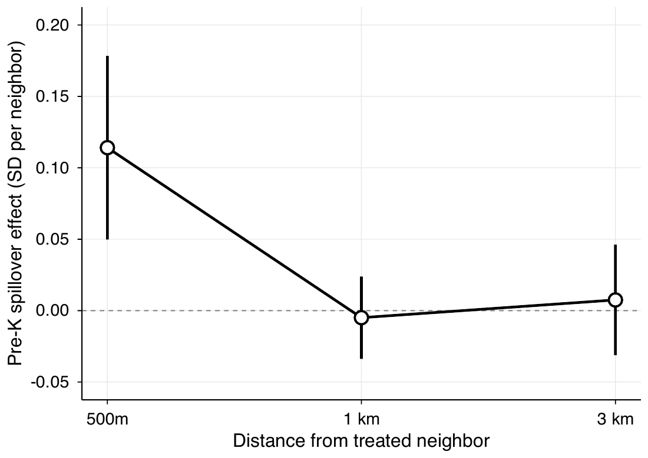
BEYOND THE PARTICIPANT · THE EVIDENCE
Education is contagious, but only within 500 meters!
0.114σ per treated Pre-K neighbor within 500m, and zero at 1km and 3km.
List, Momeni, Vlassopoulos & Zenou (2026), Figure 1. Design-based (Borusyak–Hull) specification; 95% CIs, SEs clustered at block group.

Slide 31
BEYOND THE PARTICIPANT
Spillovers change the arithmetic of social returns
Cognitive spillovers of 0.114σ per treated neighbor (mean treated neighbor is ~1)
Highly localized, a pattern consistent with local child-to-child (and parent to parent!) interaction rather than broad diffusion.
Siblings of treated children benefited too, echoing the Perry intragenerational findings.
Evaluations that stop at the participant systematically understate the social return.
neighborhood — 500m
family & siblings
treated child
List, Momeni, Vlassopoulos & Zenou, “Neighborhood Spillover Effects of Early Childhood Interventions” (CEPR DP 18134)

Slide 32
THE FRAMEWORK · ROW 1 · COMPLETE
Same object, second network: Σwθ identified twice
θ_{i,t+1} = f_{t}( θ_{i,t}, P_{i,t}, S_{i,t}, C_{i,t}, E_{i,t} ) Z_{i,t} = λ_{t} θ_{i,t} + ε_{i,t} Y_{i} = g( θ_{i,T} ) at scale n: F(n), fₙ, S(n), E(n), C(n)
Object | Economic content | Result it organizes
E: Σ wᵢⱼθⱼ | Others' skills enter your production — classrooms and neighborhoods | Gains persist with treated classmates, erode when scattered (List & Uchida); spillovers to nearby non-participants ≈ 38% of the total effect, within 500m (List, Momeni, Vlassopoulos, Zenou)
? | — | —
? | — | —
? | — | —
? | — | —
? | — | —
Same structural term, two networks, two designs — randomized w in classrooms, natural w in neighborhoods. Identified twice, same sign: the spillover sum is real, and the participant is the wrong unit of account.

Slide 33

MECHANISM 2 · PARENTS
Latent human capital: the skills were never gone
When Covid shuttered schools, it created the schooling shock no one would ever randomize. CHECC's decade-old randomization was suddenly live again.
Were any of the CHECC treatment kids different from control?
Insurance, not just investment?
Jha, List, Royer & Samek, “Latent Human Capital: How Early Investments in Parents Buffer Against Future Schooling Shocks” Coming soon!

Slide 34
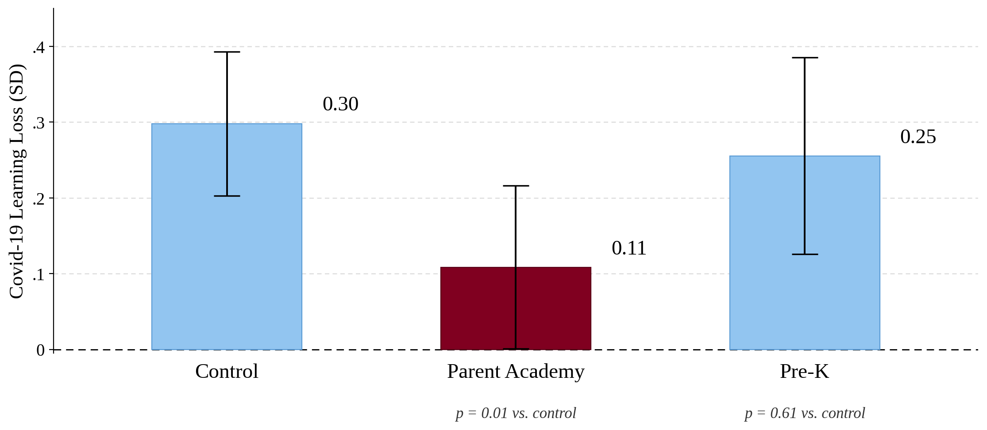
MECHANISM 2 · PARENTS · THE EVIDENCE
When schools closed, the decade-old treatment effect reappeared
0.30σ loss for controls falls to 0.11σ under Parent Academy (p = 0.01), ten years on. Pre-K: no shield (0.25σ, p = 0.61).
Jha, List, Royer & Samek (2026), Figure 2. Covid loss = 2019 minus 2021/22 IAR scale scores, in 2019 SDs; whiskers are 95% CIs. Goldhaber et al.; Betthauser et al.

Slide 35
MECHANISM 2 · PARENTS
Latent human capital: the skills were never gone
Children whose parents received early investment training weathered the shock far better
The early treatment built durable parental capacity that switched on precisely when the school input switched off.
Fade-out on test scores is not evidence the capital is gone. It can sit latent (and buffer) until circumstances call on it.
Insurance, not just investment
Early parental programs act like an insurance policy on children's human capital — a value entirely invisible to standard test-score evaluations.
Jha, List, Royer & Samek, “Latent Human Capital: How Early Investments in Parents Buffer Against Future Schooling Shocks” Coming soon!

Slide 36
THE FRAMEWORK · ROW 2
P is a stock: built early, it pays off when S fails
θ_{i,t+1} = f_{t}( θ_{i,t}, P_{i,t}, S_{i,t}, C_{i,t}, E_{i,t} ) Z_{i,t} = λ_{t} θ_{i,t} + ε_{i,t} Y_{i} = g( θ_{i,T} ) at scale n: F(n), fₙ, S(n), E(n), C(n)
Object | Economic content | Result it organizes
E: Σ wᵢⱼθⱼ | Others' skills enter your production — classrooms and neighborhoods | Gains persist with treated classmates, erode when scattered (List & Uchida); spillovers to nearby non-participants ≈ 38% of the total effect, within 500m (List, Momeni, Vlassopoulos, Zenou)
P built early | Parental capital persists; substitutes for S when schools fail | Covid closures: control children lose 0.30σ of state test scores, Parent Academy children lose 0.11σ (p = 0.01): 8–10 years post-treatment (Jha, List, Royer, Samek)
? | — | —
? | — | —
? | — | —
? | — | —

Slide 37
THE CHILD’S EFFORT · C · NEW ROW
C is movable by the designer, when effort responds to incentives!
Morning of the test:
Offer surprise “clawback” incentives just before a PISA test: U.S. versus Shanghai students
What happens?
Gneezy, List, Livingston, Qin, Sadoff & Xu, AER: Insights 1(3), 2019.

Slide 38
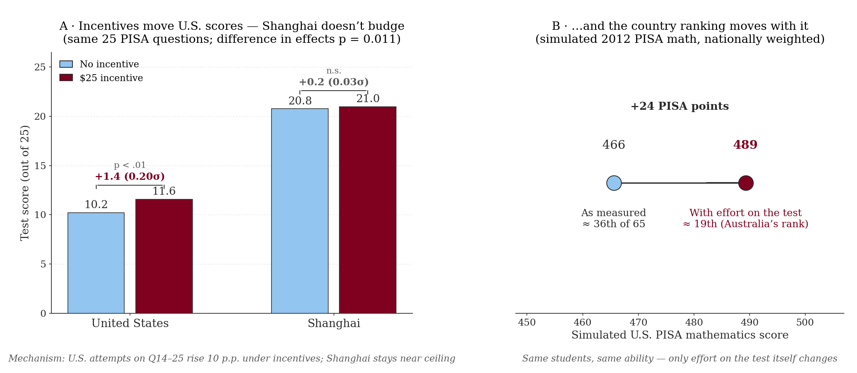
THE CHILD’S EFFORT · C · THE EVIDENCE
Test scores measure trying: worth 24 points and 17 ranks
+0.20σ U.S. score gain under a $25 incentive (p < .01); Shanghai: +0.03σ n.s. S
imulated PISA: +24 points : from 36th to ≈19th of 65, with ability unchanged.

Slide 39
THE CHILD’S EFFORT · C · NEW ROW
C is chooseable: when effort predictably responds to incentives
Student incentives
Financial and non-financial rewards move student effort, but only when delivered immediately. Loss-framed, prepaid rewards lift math ~0.12σ; introduce any delay and the motivating power vanishes.
Levitt, List, Neckermann & Sadoff, AEJ: Economic Policy, 2016.
No lasting crowd-out
Incentives move incented tests, and any crowd-out of intrinsic motivation is temporary: treated students outperform a year later.
List, Livingston & Neckermann, Economics of Education Review, 2018.
In the model: C can be changed by the designer, the child prices effort, it enters the technology f, and it enters the score Z. Not all of θ shows up unless C does.
Three experiments, one object: the child’s own investment C. Full citations in References.

Slide 40
THE FRAMEWORK · ROW 3
C is a choice: the child supplies the effort
θ_{i,t+1} = f_{t}( θ_{i,t}, P_{i,t}, S_{i,t}, C_{i,t}, E_{i,t} ) Z_{i,t} = λ_{t} θ_{i,t} + ε_{i,t} Y_{i} = g( θ_{i,T} ) at scale n: F(n), fₙ, S(n), E(n), C(n)
Object | Economic content | Result it organizes
E: Σ wᵢⱼθⱼ | Others' skills enter your production — classrooms and neighborhoods | Gains persist with treated classmates, erode when scattered (List & Uchida); spillovers to nearby non-participants ≈ 38% of the total effect, within 500m (List, Momeni, Vlassopoulos, Zenou)
P built early | Parental capital persists; substitutes for S when schools fail | Covid closures: control children lose 0.30σ of state test scores, Parent Academy children lose 0.11σ (p = 0.01) — 8–10 years post-treatment (Jha, List, Royer, Samek)
C: child’s effort | The child’s own investment: effort enters f, and it is in the score Z | Loss-framed, prepaid rewards lift math ~0.12σ; delay kills the effect (Levitt, List, Neckermann, Sadoff); no lasting crowd-out (List, Livingston, Neckermann); $25 lifts U.S. scores 0.20σ, Shanghai nil (Gneezy et al.)
? | — | —
Row three filled: effort responds to price, decays with delay — and it lives inside Z. That contamination is exactly where the measurement map comes in next.

Slide 41

MECHANISM 3 · THE BRAIN — NEW
Take the Students to the EEG to Explore Executive Function
We built a space-themed EEG lab in a Chicago Heights storefront and measured brain activity of 72 CHECC children (36 preschool, 36 control).
The task: press a button for every animal except the dog. Dog trials force the brain to slam the brakes: inhibitory control, the core of executive function.
The measure: N2, the electrical signature of that braking.
If Preschool children show greater N2 on braking trials , then their inhibitory system is more engaged
Reall that in our measures behavioral EF tests (Fryer et al. 2020) barely moved in pre-school treatment.
Do the hands hide what the cortex is doing?
Why it matters
Behavioral tests confound skill with motor control and test-day effort. Neural measures see through that.
EEG biomarkers are candidate statistical surrogates (Athey et al.) : forecasting long-run effects without a 40-year wait.
This study combines EEG and behavioral tasks to evaluate a preschool intervention.
Ye, Samek, Yoder, Decety, Hortaçsu & List, “Early Childhood Programs Change Test Scores but Do They Change Brain Activity?” (working paper).

Slide 42
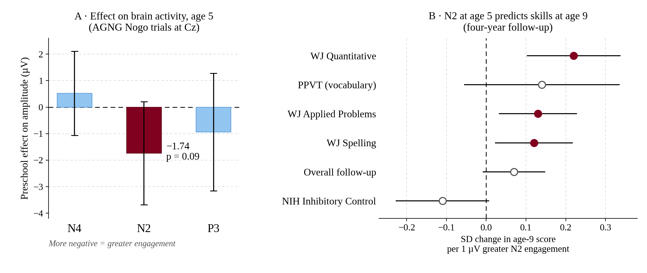
MECHANISM 3 · THE BRAIN · THE EVIDENCE
The N2 moved at age 5, & predicted skills at age 9
1.74 µV deeper N2 under preschool (p = 0.09); each µV predicts +0.22σ in age-9 math. Behavioral EF tests saw nothing.
Ye, Samek, Yoder, Decety, Hortaçsu & List (working paper), Tables 3–4. n = 35 (EEG), 22 (follow-up); whiskers are 95% CIs; filled markers p < 0.05.

Slide 43
THE FRAMEWORK · ROW 4
λ is not the identity map: Z is a proxy, θ is the object
θ_{i,t+1} = f_{t}( θ_{i,t}, P_{i,t}, S_{i,t}, C_{i,t}, E_{i,t} ) Z_{i,t} = λ_{t} θ_{i,t} + ε_{i,t} Y_{i} = g( θ_{i,T} ) at scale n: F(n), fₙ, S(n), E(n), C(n)
Object | Economic content | Result it organizes
E: Σ wᵢⱼθⱼ | Others' skills enter your production: classrooms and neighborhoods | Gains persist with treated classmates, erode when scattered (List & Uchida); spillovers to nearby non-participants ≈ 38% of the total effect, within 500m (List, Momeni, Vlassopoulos, Zenou)
P built early | Parental capital persists; substitutes for S when schools fail | Covid closures: control children lose 0.30σ of state test scores, Parent Academy children lose 0.11σ (p = 0.01) — 8–10 years post-treatment (Jha, List, Royer, Samek)
C: child’s effort | The child’s own investment: effort enters f, and it is in the score Z | Loss-framed, prepaid rewards lift math ~0.12σ; delay kills the effect (Levitt, List, Neckermann, Sadoff); no lasting crowd-out (List, Livingston, Neckermann); $25 lifts U.S. scores 0.20σ, Shanghai nil (Gneezy et al.)
λ < 1, ε ≠ 0 | Z can fade or stall while θ moves: measurement is not the object | Behavioral EF gains small & n.s. (Fryer et al. 2020); preschoolers show greater N2 during Go-Nogo (p < 0.1, n = 72); EEG predicts skills 4 yrs later beyond baseline behavioral measures (Ye et al.)
? | — | —
? | — | —

Slide 44
THE LIVING LAB · I
CHECC breathes: θ is wider than test scores
Because children came to us daily, CHECC doubled as a behavioral laboratory. We elicited preferences, social behavior, and moral behavior from thousands of children. Each experiment identifies an object in the framework.
Social preferences
θ
Randomize early education, then elicit distributive choices: preschool makes children markedly more egalitarian in their fairness views, while the parenting arm tilts them toward efficiency.
In the model: fairness views are coordinates of θ, and f moves them. Education changes values, not just skills.
Cappelen, List, Samek & Tungodden, “The Effect of Early Childhood Education on Social Preferences,” Journal of Political Economy 128(7), 2020.
1 / 8

Slide 45
THE LIVING LAB · I
CHECC breathes: θ is wider than test scores
Because children came to us daily, CHECC doubled as a behavioral laboratory. We elicited preferences, social behavior, and moral behavior from thousands of children — and each experiment identifies an object in the framework. Watch the badges: this is the census of θ and its neighbors.
Social preferences
θ
Time preferences
θ
1,200+ children ages 3–12 making incentivized intertemporal choices: patience develops substantially with age, with marked differences across racial groups.
In the model: the discount rate is a coordinate of θ with its own developmental path.
Andreoni, Kuhn, List, Samek, Sokal & Sprenger, “Toward an Understanding of the Development of Time Preferences: Evidence from Field Experiments,” Journal of Public Economics 177, 2019.
2 / 8

Slide 46
THE LIVING LAB · I
CHECC breathes: θ is wider than test scores
Because children came to us daily, CHECC doubled as a behavioral laboratory. We elicited preferences, social behavior, and moral behavior from thousands of children — and each experiment identifies an object in the framework. Watch the badges: this is the census of θ and its neighbors.
Social preferences
θ
Risk & ambiguity
θ
Time preferences
θ
1,400+ children ages 3–15: the famous gender gap in risk aversion is absent in childhood and emerges only in early adolescence, and math skill predicts risk-taking.
In the model: risk attitudes sit in θ, and the gender coordinate switches on in adolescence, not at birth.
Andreoni, Di Girolamo, List, Mackevicius & Samek, “Risk Preferences of Children and Adolescents in Relation to Gender, Cognitive Skills, Soft Skills, and Executive Functions,” J. Economic Behavior & Organization 179, 2020.
3 / 8

Slide 47
THE LIVING LAB · I
CHECC breathes: θ is wider than test scores
Because children came to us daily, CHECC doubled as a behavioral laboratory. We elicited preferences, social behavior, and moral behavior from thousands of children — and each experiment identifies an object in the framework. Watch the badges: this is the census of θ and its neighbors.
Social preferences
θ
Preferences → outcomes
g
Time preferences
θ
Skills load on three factors, cognition, executive function, preferences. It is EF and early impatience, not cognition, that predict disciplinary referrals years later.
Risk & ambiguity
θ
In the model: this identifies g: which coordinates of θ actually carry into Y. Not the ones tests reward.
Castillo, List, Petrie & Samek, “Detecting Drivers of Behavior at an Early Age: Evidence from a Longitudinal Field Experiment,” Journal of Political Economy 132(12), 2024.
4 / 8

Slide 48
THE LIVING LAB · I
CHECC breathes: θ is wider than test scores
Because children came to us daily, CHECC doubled as a behavioral laboratory. We elicited preferences, social behavior, and moral behavior from thousands of children — and each experiment identifies an object in the framework. Watch the badges: this is the census of θ and its neighbors.
Social preferences
θ
Theory of mind
λ
Time preferences
θ
Disadvantaged children's low theory-of-mind performance improves sharply when other children's presence is made salient. It is partly attention, not capacity. And ToM competence predicts less sharing: strategic minds hold back.
Risk & ambiguity
θ
Preferences → outcomes
g
In the model: partly a λ result, measured ToM confounds attention with capacity. The map, not the mind.
Charness, List, Rustichini, Samek & van de Ven, “Theory of Mind Among Disadvantaged Children: Evidence from a Field Experiment,” JEBO 166, 2019; Cowell, Samek, List & Decety, “The Curious Relation Between Theory of Mind and Sharing in Preschool Age Children,” PLoS ONE 10(2), 2015.
5 / 8

Slide 49
THE LIVING LAB · I
CHECC breathes: θ is wider than test scores
Because children came to us daily, CHECC doubled as a behavioral laboratory. We elicited preferences, social behavior, and moral behavior from thousands of children — and each experiment identifies an object in the framework. Watch the badges: this is the census of θ and its neighbors.
Social preferences
θ
Dishonesty at home
P
Time preferences
θ
Put parents in a die-roll task with real stakes: they cheat, but markedly less when their children are watching, and especially in front of daughters.
Risk & ambiguity
θ
Preferences → outcomes
g
Theory of mind
λ
In the model: P transmits norms, not just skills: the home writes θ's moral coordinates.
Houser, List, Piovesan, Samek & Winter, “Dishonesty: From Parents to Children,” European Economic Review 82, 2016.
6 / 8

Slide 50
THE LIVING LAB · I
CHECC breathes: θ is wider than test scores
Because children came to us daily, CHECC doubled as a behavioral laboratory. We elicited preferences, social behavior, and moral behavior from thousands of children — and each experiment identifies an object in the framework. Watch the badges: this is the census of θ and its neighbors.
Social preferences
θ
Discrimination
θ₀
Time preferences
θ
In incentivized allocation tasks, discriminatory behavior is detectable already among preschoolers, before formal schooling begins.
Risk & ambiguity
θ
Preferences → outcomes
g
Theory of mind
λ
In the model: the initial condition θ₀ already contains social preferences over groups. Policy starts before school does.
Dishonesty at home
P
List, List & Samek, “Discrimination Among Pre-School Children: Field Experimental Evidence,” Economics Letters 157, 2017.
7 / 8

Slide 51
THE LIVING LAB · I
CHECC breathes: θ is wider than test scores
Because children came to us daily, CHECC doubled as a behavioral laboratory. We elicited preferences, social behavior, and moral behavior from thousands of children — and each experiment identifies an object in the framework. Watch the badges: this is the census of θ and its neighbors.
Social preferences
θ
Health behaviors
f
Time preferences
θ
Small incentives lift healthy snack choice from 17% to roughly 75%, with evidence of habit formation after incentives end.
Risk & ambiguity
θ
Preferences → outcomes
g
Theory of mind
λ
In the model: incentives are an input in f, and habit formation is ∂f/∂θ at work on behavior.
Dishonesty at home
P
List & Samek, “The Behavioralist as Nutritionist: Leveraging Behavioral Economics to Improve Child Food Choice and Consumption,” Journal of Health Economics 39, 2015.
Discrimination
θ₀
8 / 8

Slide 52
THE LIVING LAB · I
CHECC breathes: θ is wider than test scores
Because children came to us daily, CHECC doubled as a behavioral laboratory. We elicited preferences, social behavior, and moral behavior from thousands of children — and each experiment identifies an object in the framework. Watch the badges: this is the census of θ and its neighbors.
Social preferences
θ
Time preferences
θ
Risk & ambiguity
θ
Preferences → outcomes
g
Preschool makes children more egalitarian; the parenting arm shifts them toward efficiency.
1,200+ children ages 3–12: patience develops substantially with age, with marked racial differences.
The gender gap in risk aversion is absent in childhood — it emerges in early adolescence.
EF and early impatience — not cognition — predict disciplinary referrals years later.
Cappelen, List, Samek & Tungodden, “The Effect of Early Childhood Education on Social Preferences,” Journal of Political Economy 128(7), 2020.
Andreoni, Kuhn, List, Samek, Sokal & Sprenger, “Toward an Understanding of the Development of Time Preferences: Evidence from Field Experiments,” Journal of Public Economics 177, 2019.
Andreoni, Di Girolamo, List, Mackevicius & Samek, “Risk Preferences of Children and Adolescents in Relation to Gender, Cognitive Skills, Soft Skills, and Executive Functions,” J. Economic Behavior & Organization 179, 2020.
Castillo, List, Petrie & Samek, “Detecting Drivers of Behavior at an Early Age: Evidence from a Longitudinal Field Experiment,” Journal of Political Economy 132(12), 2024.
Theory of mind
λ
Dishonesty at home
P
Discrimination
θ₀
Health behaviors
f
Disadvantaged children's low ToM improves sharply when other children's presence is made salient — and ToM predicts less sharing, not more.
Parents cheat less when their children are watching — especially daughters. Honesty transmission starts at home.
Discriminatory behavior is detectable in incentivized tasks already among preschoolers — before formal schooling begins.
Small incentives lift healthy snack choice from 17% to ~75%, with evidence of habit formation.
Charness, List, Rustichini, Samek & van de Ven, “Theory of Mind Among Disadvantaged Children: Evidence from a Field Experiment,” JEBO 166, 2019; Cowell, Samek, List & Decety, “The Curious Relation Between Theory of Mind and Sharing in Preschool Age Children,” PLoS ONE 10(2), 2015.
Houser, List, Piovesan, Samek & Winter, “Dishonesty: From Parents to Children,” European Economic Review 82, 2016.
List, List & Samek, “Discrimination Among Pre-School Children: Field Experimental Evidence,” Economics Letters 157, 2017.
List & Samek, “The Behavioralist as Nutritionist: Leveraging Behavioral Economics to Improve Child Food Choice and Consumption,” Journal of Health Economics 39, 2015.
Badges: θ skills & preferences · θ₀ initial conditions · P parents · λ measurement · f technology · g outcome map. Survey: List, Petrie, Samek (JEL 2023); full titles in References.

Slide 53
THE FRAMEWORK · ROW 5
Many parts of “skills” carry into Y
θ_{i,t+1} = f_{t}( θ_{i,t}, P_{i,t}, S_{i,t}, C_{i,t}, E_{i,t} ) Z_{i,t} = λ_{t} θ_{i,t} + ε_{i,t} Y_{i} = g( θ_{i,T} ) at scale n: F(n), fₙ, S(n), E(n), C(n)
Object | Economic content | Result it organizes
E: Σ wᵢⱼθⱼ | Others' skills enter your production: classrooms and neighborhoods | Gains persist with treated classmates, erode when scattered (List & Uchida); spillovers to nearby non-participants ≈ 38% of the total effect, within 500m (List, Momeni, Vlassopoulos, Zenou)
P built early | Parental capital persists; substitutes for S when schools fail | Covid closures: control children lose 0.30σ of state test scores, Parent Academy children lose 0.11σ (p = 0.01) — 8–10 years post-treatment (Jha, List, Royer, Samek)
C: child’s effort | The child’s own investment: effort enters f, and it is in the score Z | Loss-framed, prepaid rewards lift math ~0.12σ; delay kills the effect (Levitt, List, Neckermann, Sadoff); no lasting crowd-out (List, Livingston, Neckermann); $25 lifts U.S. scores 0.20σ, Shanghai nil (Gneezy et al.)
λ < 1, ε ≠ 0 | Z can fade or stall while θ moves: measurement is not the object | Behavioral EF gains small & n.s. (Fryer et al. 2020); preschoolers show greater N2 during Go-Nogo (p < 0.1, n = 72); EEG predicts skills 4 yrs later beyond baseline behavioral measures (Ye et al.)
g: θ → Y | Which coordinates of θ cash out: and which choices they drive | 1σ of EF → −1.9 pp referral probability, 1σ of patience → −2.3 pp (14.7% base); cognition: nil (Castillo, List, Petrie, Samek); preferences & beliefs, not ability, drive STEM sorting (Fiala et al.)
? | — | —
The living lab filled g: EF and preferences, not solely test scores, are what carry into outcomes.

Slide 54
SCALE · N
Scaling lives inside the model, not after it
Five vital signs, five objects. A voltage drop is not one wedge: each vital sign attacks a different part of the model, and only the supply-side trap runs through S.
False positives live in the estimate, not the technology. Unrepresentative samples shift the population F(n) you draw from, so heterogeneity bites. Unrepresentative situations change f itself. Costs hit C(n) directly.
CHECC's additional ledger entry: the spillover vital sign can run positive. Peer density E(n) rises with coverage, fade-out mutes when classmates are treated, and neighborhood effects grow with saturation. Whether scaling drops or gains voltage is an empirical horse race, object by object.
The design implication: Option C Thinking (List, 2024, Nature) backward induct from the scale you intend, choose samples, situations, and dosages so the pilot estimates the policy parameter, not the pilot parameter.
False positives
Δ̂ — the inference, not the technology
Unrepresentative sample
F(n) — who you draw shifts; heterogeneity bites
Unrepresentative situation
fₙ — the technology changes with delivery
Supply side & cost trap
S(n) quality falls; C(n) marginal costs rise
Spillovers & GE
E(n) — CHECC: this one can run positive
List, The Voltage Effect (2022); List, “The Economics of Scaling Early Childhood Programs: Lessons from the Chicago School,” Journal of Political Economy 134(1), 2026; List, “Optimally Generate Policy-Based Evidence Before Scaling,” Nature 626 (2024).

Slide 55
THE FRAMEWORK · ROW 6 · COMPLETE
Scaling is an argument at the beginning, not the end
θ_{i,t+1} = f_{t}( θ_{i,t}, P_{i,t}, S_{i,t}, C_{i,t}, E_{i,t} ) Z_{i,t} = λ_{t} θ_{i,t} + ε_{i,t} Y_{i} = g( θ_{i,T} ) at scale n: F(n), fₙ, S(n), E(n), C(n)
Object | Economic content | Result it organizes
E: Σ wᵢⱼθⱼ | Others' skills enter your production: classrooms and neighborhoods | Gains persist with treated classmates, erode when scattered (List & Uchida); spillovers to nearby non-participants ≈ 38% of the total effect, within 500m (List, Momeni, Vlassopoulos, Zenou)
P built early | Parental capital persists; substitutes for S when schools fail | Covid closures: control children lose 0.30σ of state test scores, Parent Academy children lose 0.11σ (p = 0.01): 8–10 years post-treatment (Jha, List, Royer, Samek)
C: child’s effort | The child’s own investment: effort enters f, and it is in the score Z | Loss-framed, prepaid rewards lift math ~0.12σ; delay kills the effect (Levitt, List, Neckermann, Sadoff); no lasting crowd-out (List, Livingston, Neckermann); $25 lifts U.S. scores 0.20σ, Shanghai nil (Gneezy et al.)
λ < 1, ε ≠ 0 | Z can fade or stall while θ moves: measurement is not the object | Behavioral EF gains small & n.s. (Fryer et al. 2020); preschoolers show greater N2 during Go-Nogo (p < 0.1, n = 72); EEG predicts skills 4 yrs later beyond baseline behavioral measures (Ye et al.)
g: θ → Y | Which coordinates of θ cash out: and which choices they drive | 1σ of EF → −1.9 pp referral probability, 1σ of patience → −2.3 pp (14.7% base); cognition: nil (Castillo, List, Petrie, Samek); preferences & beliefs, not ability, drive STEM sorting (Fiala et al.)
n: scale | Five vital signs, five objects: inference on Δ̂, sample F(n), technology fₙ, inputs S(n) & costs C(n), environment E(n) | Dosage: 2 summer months ≈ an academic year (~0.25σ); whether V(n) rises or falls is S(n) vs E(n) — an empirical horse race (List, JPE 2026; Nature 2024)
The map is complete: environment E on two networks, parents P, the child’s effort C, measurement λ, outcome map g, and scale n. One system, a dozen papers, no black box.

Slide 56
EXTENDING THE ARC · NEW
It's not over at five: skill compounds, and efficiency divides
Why doesn’t adolescent Johnny do well in school?
Cotton et al.: model of time allocation and academic efficiency.
Black and Hispanic students are as motivated as White/Asian peers, but academic efficiency runs ~1σ (Black) and ~0.7σ (Hispanic) lower, conditional on school, family, and neighborhood. Schools act on efficiency: the best-to-worst-resourced district gap predicts a 0.6σ drop.
Cotton, Hickman, List, Price & Roy, “Why Don't Struggling Students Do Their Homework? Disentangling Motivation and Study Productivity as Drivers of Human Capital Formation,” Journal of Political Economy, 2026.
Joensen et al.: skill begets skill; 18 classroom hours lift cognition +0.12σ (Math) and EF +0.13σ (Goals). Seven years on, +6.3 p.p. 4-year college enrollment off a 25% base.
Joensen, List, Samek & Uchida, “Using a Field Experiment to Understand Skill Formation During Adolescence” (coming soon)

Slide 57
THE LIVING LAB · II
Teacher Incentives, effort, and the anatomy of gaps could fill another table!
The lab also ran on the adults and institutions around the children: identifying the inputs P and S, the outcome map g, and the distribution F. The census continues.
Teacher incentives
S
Racial Excellence gaps
F
Gender gaps start at home
P
Preferences → pipelines
g
Loss-framed prepaid bonuses raise math achievement ~0.12σ; conventional gain-framed bonuses do little.
The racial excellence gap among top achievers appears by 3rd grade and grows; average-gap policies barely move it.
Differential early parental investments help explain where the math and literacy gender gaps originate.
Early gender differences in preferences and beliefs — not ability — drive high-school STEM sorting and college major gaps.
Fryer, Levitt, List & Sadoff, “Enhancing the Efficacy of Teacher Incentives through Framing: A Field Experiment,” AEJ: Economic Policy 14(4), 2022.
Karna, Lee, List, Simon & Uchida, “Measuring Racial Educational Disparities Over Time Amongst Top Achievers,” Nature 639, 2025.
Chuan, List, Samek & Samujjwala, “Parental Investments in Early Childhood and the Gender Gap in Math and Literacy,” AEA Papers & Proceedings 112, 2022.
Fiala, Humphries, Joensen, Karna, List & Veramendi, “How Early Adolescent Skills and Preferences Shape Economics Education Choices,” AEA Papers & Proceedings 112, 2022.
First Gen Excellence gaps
The First-gen excellence gap among top achievers appears by 1st grade and grows
Karna, List, Simon & Uchida, “Th First-Gen Excellence Gap, Nature Human Behavior, forthcoming.
.
Beliefs are the root
P
F
Low-SES parents underestimate the returns to investment; beliefs are malleable, and intensive programs move investments and skills.
List, Pernaudet & Suskind, “Shifting Parental Beliefs About Child Development to Foster Parental Investments and Improve School Readiness Outcomes,” Nature Communications 12, 2021.

Slide 58
THEN AND NOW
Same question, different machine
Dimension | Perry (1962–67) | CHECC (2010–2014; experiments until 2026)
Sample | 123 children | ~3,000 children
Treatment arms | 1 bundled (preschool + home visits) | 4 arms: Preschool, Parent Academy, Kinderprep, Control
Mechanism data | None at treatment | Preferences, parental beliefs, EEG brain activity
Spillovers | Not measured | Neighborhood (500m) + classroom peer effects
Parental channel | Undecomposed home visits | Separate Parent Academy arm isolates the channel
Scaling evidence | None built in | Kinderprep dosage, district-led replications, voltage framework
Later-life arc | 40-year wait | Tracked in real time; adolescent interventions extend the arc

Slide 59

THE BIGGER PICTURE
Standard evaluations get the returns wrong in both directions
They overestimate when…
…and underestimate when
Test-score gains fade with untreated peers and get read as durable skill
Endogenous compliance inflates factorial treatment estimates
Test-day effort, not skill, moves the measured outcome
Pilot inputs are the best inputs: S(n) degrades as supply stretches at scale
Spillovers to neighbors and siblings are left out of the ledger
Latent parental capital only pays off when shocks arrive
Neural changes precede, and predict, what behavioral tests eventually detect
Peer density E(n) strengthens with coverage; universal provision mutes fade-out

Slide 60
TAKEAWAYS · PICK YOUR SEAT
One platform, six lessons
FOR POLICYMAKERS
FOR ACADEMICS
FOR PRACTITIONERS
Buy the system, not the pilot.
Build platforms, not projects.
The classroom is tunable.
Fund at coverage levels that activate peer effects: universal provision changes efficiency itself, not just equity. Never cancel on 3rd-grade fade-out: latent capital and spillovers are off the test. Commission evidence at the scale you intend.
A randomization is an asset that appreciates: a 2010 coin flip became a 2026 paper when Covid hit. One-shot RCTs estimate a number; platforms identify the objects — f, P, E, λ, n.
Dosage is a lever: two summer months ≈ an academic year, and gains front-load in four months. Composition sustains skills. Reward immediately; frame teacher bonuses as losses; teach EF, not just content.
FOR PARENTS
FOR EXPERIMENTALISTS
FOR METHODS PEOPLE
You are the durable input.
Design for the violations.
Respect the measurement map.
The binding constraint is your belief that investment matters, it does. And, for longer than you think: parental capital built at age 4 buffered a shock at age 14. And children copy what they watch: honesty, patience, sharing.
Randomize environments, not just treatments. Measure the non-participants; if in the design, SUTVA violations are findings, not nuisances. Put the lab where people live, and fifty studies ride one platform at near-zero marginal cost.
Z ≠ θ: effort, motor control, and λ < 1 all sit between skill and score. Bring MHT corrections, compliance-aware factorial estimators, and surrogate indices.

Slide 61
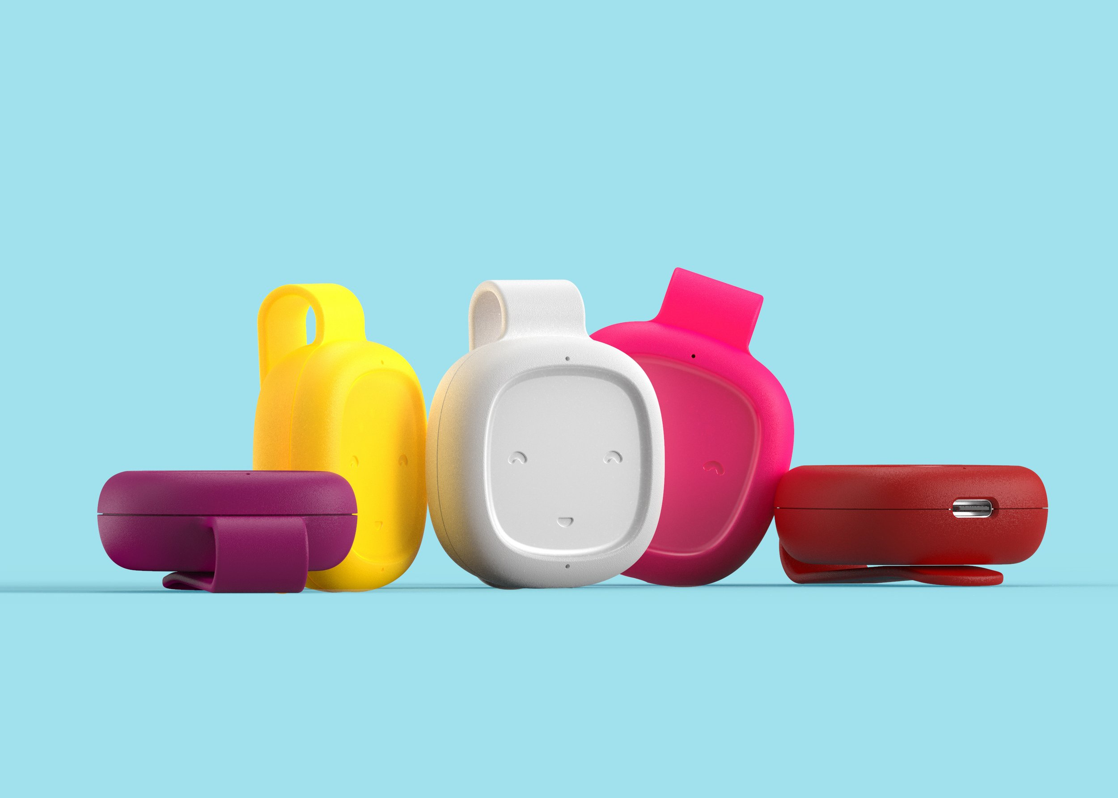
WHERE TO NEXT · THE NEXT INSTRUMENT
Where to next: when λ becomes an input, f changes
In a state-wide test across 1-3 year olds in Connecticut……
testable predictions, mapped one-to-one to the design and the device panel

Slide 62
WHERE TO NEXT · THE NEXT INSTRUMENT
Where to next: when λ becomes an input, f changes
Our Model: Teacher allocates rival directed speech and nonrival ambient words across children under an information friction. Think mixed private/public good model.
Treatment operates on three margins: it moves the classroom from inside its production possibilities frontier to the frontier, expands the frontier, and moves the allocation along it toward the inclusive point.
The arc closes where it began: the deck opened with λ as a ruler. Where we are headed, λ is an input the teacher holds, and every classroom is a living lab.
testable predictions, mapped one-to-one to the design and the device panel
List, Pernaudet, Royer, & Suskind, Making the Invisible Visible: Toward an Understanding of the Effects of Classroom Interactions.

Slide 63
There is a New Landscape Emerging
Yesterday’s economist visited the pin factory to scribe general economic theories.
Today’s economist models natural disruptions that affect the pin factory and occasionally generates data from the pin factory to test economic theories.
Tomorrow’s economist (ALL OF US) will surgically control the assignment mechanism, in an ethically responsible way, to provide causal evidence of the inner workings of the pin factory and simultaneously generate data necessary to understand if learnings from that environment will transfer to other environments, whether spatially, temporally, or scale differentiated.

Slide 64
REFERENCES · I
The platform, the mechanisms, and scaling
Fryer, Levitt & List (2015), “Parental Incentives and Early Childhood Achievement: A Field Experiment in Chicago Heights,” NBER WP 21477.
Fryer, Levitt, List & Samek (2020), “Introducing CogX: A New Preschool Education Program Combining Parent and Child Interventions,” NBER WP 27913.
List & Uchida (2024), “Here Today, Gone Tomorrow? Toward an Understanding of Fade-out in Early Childhood Education Programs,” NBER WP 33027.
Jha, List, Royer & Samek (2026), “Latent Human Capital: How Early Investments in Parents Buffer Against Future Schooling Shocks.”
Ye, Samek, Yoder, Decety, Hortaçsu & List, “Early Childhood Programs Change Test Scores but Do They Change Brain Activity?” Working paper.
List, Momeni, Vlassopoulos & Zenou (2023), “Neighborhood Spillover Effects of Early Childhood Interventions,” CEPR DP 18134 / NBER WP 28283; R&R, AEJ: Economic Policy.
Castillo, List, Petrie & Samek (2024), “Detecting Drivers of Behavior at an Early Age: Evidence from a Longitudinal Field Experiment,” J. Political Economy 132(12).
Chuan, List & Samek (2021), “Do Financial Incentives Aimed at Decreasing Interhousehold Inequality Increase Intrahousehold Inequality?” J. Public Economics 196.
Joensen, List, Samek & Uchida, “Using a Field Experiment to Understand Skill Formation During Adolescence.”
Cotton, Hickman, List, Price & Roy, “Why Don't Struggling Students Do Their Homework? Disentangling Motivation and Study Productivity as Drivers of Human Capital Formation,” J. Political Economy.
List (2026), “The Economics of Scaling Early Childhood Programs: Lessons from the Chicago School,” J. Political Economy 134(1).
List (2024), “Optimally Generate Policy-Based Evidence Before Scaling,” Nature 626, 491–499.
List, Petrie & Samek (2023), “How Experiments with Children Inform Economics,” J. Economic Literature 61(2).
Heckman, Moon, Pinto, Savelyev & Yavitz (2010), “The Rate of Return to the HighScope Perry Preschool Program,” J. Public Economics 94.

Slide 65
REFERENCES · II
The living lab
Cappelen, List, Samek & Tungodden (2020), “The Effect of Early Childhood Education on Social Preferences,” J. Political Economy 128(7).
Andreoni, Kuhn, List, Samek, Sokal & Sprenger (2019), “Toward an Understanding of the Development of Time Preferences: Evidence from Field Experiments,” J. Public Economics 177.
Andreoni, Di Girolamo, List, Mackevicius & Samek (2020), “Risk Preferences of Children and Adolescents in Relation to Gender, Cognitive Skills, Soft Skills, and Executive Functions,” J. Economic Behavior & Organization 179.
Charness, List, Rustichini, Samek & van de Ven (2019), “Theory of Mind Among Disadvantaged Children: Evidence from a Field Experiment,” J. Economic Behavior & Organization 166.
Cowell, Samek, List & Decety (2015), “The Curious Relation Between Theory of Mind and Sharing in Preschool Age Children,” PLoS ONE 10(2).
Houser, List, Piovesan, Samek & Winter (2016), “Dishonesty: From Parents to Children,” European Economic Review 82.
List, List & Samek (2017), “Discrimination Among Pre-School Children: Field Experimental Evidence,” Economics Letters 157.
List & Samek (2015), “The Behavioralist as Nutritionist: Leveraging Behavioral Economics to Improve Child Food Choice and Consumption,” J. Health Economics 39.
Fryer, Levitt, List & Sadoff (2022), “Enhancing the Efficacy of Teacher Incentives through Framing: A Field Experiment,” AEJ: Economic Policy 14(4).
Levitt, List, Neckermann & Sadoff (2016), “The Behavioralist Goes to School: Leveraging Behavioral Economics to Improve Educational Performance,” AEJ: Economic Policy 8(4).
List, Livingston & Neckermann (2018), “Do Financial Incentives Crowd Out Intrinsic Motivation to Perform on Standardized Tests?” Economics of Education Review 66.
Gneezy, List, Livingston, Qin, Sadoff & Xu (2019), “Measuring Success in Education: The Role of Effort on the Test Itself,” AER: Insights 1(3).
Karna, Lee, List, Simon & Uchida (2025), “Measuring Racial Educational Disparities Over Time Amongst Top Achievers,” Nature 639.
Chuan, List, Samek & Samujjwala (2022), “Parental Investments in Early Childhood and the Gender Gap in Math and Literacy,” AEA Papers & Proceedings 112.
Fiala, Humphries, Joensen, Karna, List & Veramendi (2022), “How Early Adolescent Skills and Preferences Shape Economics Education Choices,” AEA Papers & Proceedings 112.
List, Pernaudet & Suskind (2021), “Shifting Parental Beliefs About Child Development to Foster Parental Investments and Improve School Readiness Outcomes,” Nature Communications 12.

